Slide 1
GAUGES & IT’S CLASSIFICATION

Slide 2
Gauges
single-size fixed-type measuring tools.
Gauge do not indicate the actual value of the inspected part of the component.
They are used to determine whether the part is made within the specified limit.
Materials which are used for making gauges are high carbon steel, alloy steels, cemented carbides, etc.

Slide 3
Classifications of Gauges
(a) Based on the standard and limit
(b) Based on the consistency in manufacturing and inspection
(c) Depending on the elements to be checked

Slide 4
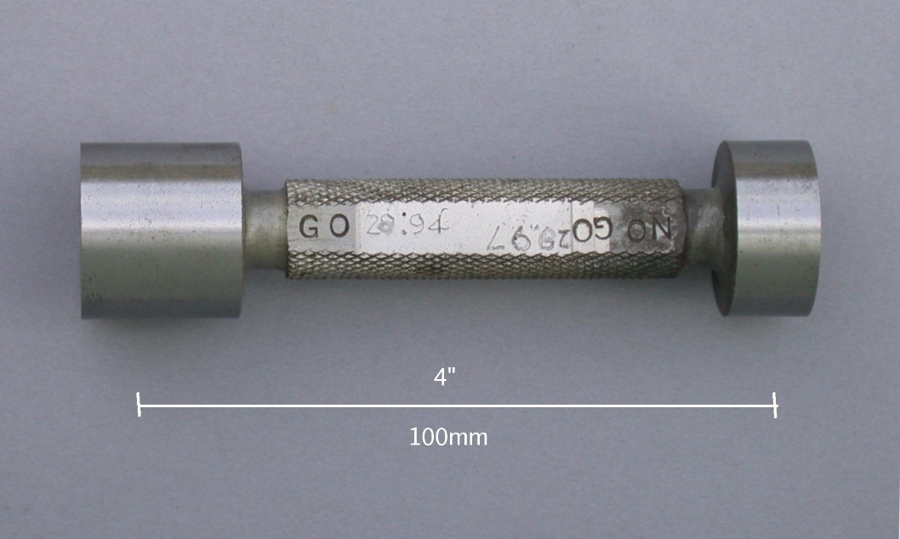
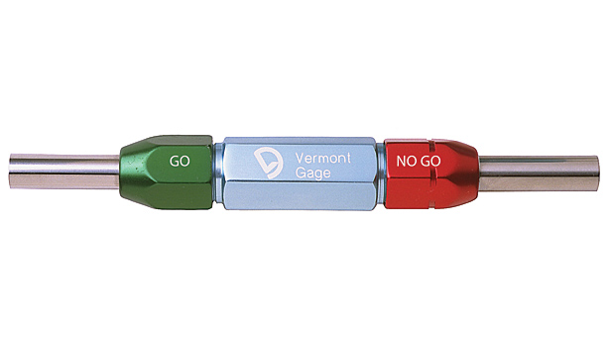
(a) Based on the standard and limit
Standard gauges
Limit gauges
Standard gauges- made as an exact copy of opposed(mating) part
Limit gauges- made to the limits of the dimensions (GO and NO GO gauges)
GO and NO GO gauges

Slide 5
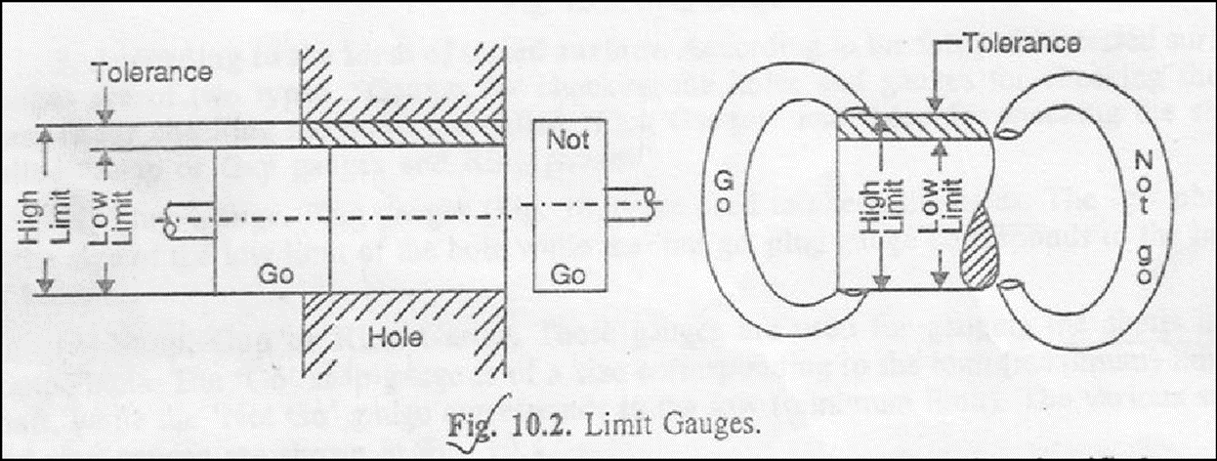

Slide 6
(b) Based on the consistency in manufacturing and inspection
To promote consistency in manufacturing and inspection, gauges may be classified as working, inspection, and reference or master gauges :
Working Gauges
Working gauges are those used at the bench or machine in gauging the work as it being made.
Inspection Gauges
These gauges are used by the inspection personnel to inspect manufactured parts when finished.
Reference Gauges
These are also called master gauges. These are used only for checking the size or condition of other gauges and represent as exactly as possible the physical dimensions of the product.

Slide 7
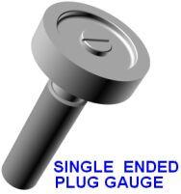
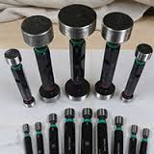
(c) Depending on the elements to be checked
Gauges for checking holes (plug gauges)
These gauges are used for checking holes of many different shapes and sizes. There are plug gauges for straight cylindrical holes, tapered, threaded square and splined holes.

Slide 8
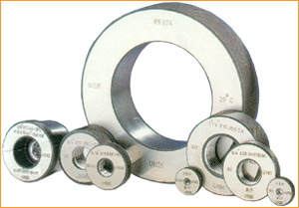
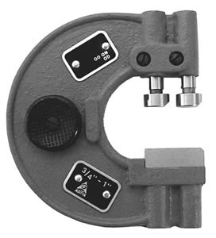
Gauges for checking Shafts (ring gauges and snap gauges)
Ring gauges are used to test external diameters. They allow shafts to be checked more accurately since they embrace the whole of their surface.
RING GAUGES SNAP GAUGE
Snap gauges are used for checking external dimensions. Shafts are mainly checked by snap gauges. They may be solid and progressive or adjustable or double-ended
.

Slide 9
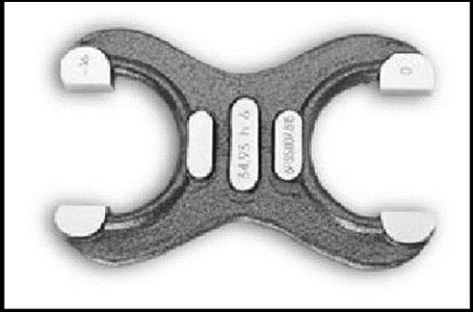
Snap gauge for checking shafts (double ended)

Slide 10
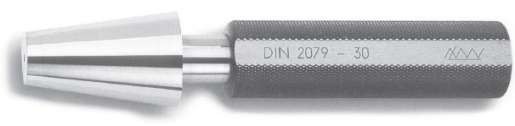
Gauges for checking taper (Taper Gauges)
The most satisfactory method of testing a taper is to use taper gauges.

Slide 11
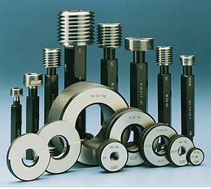
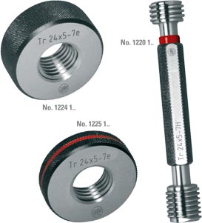
Gauges for checking threads (Thread Gauge)
Thread gauges are used to check the pitch diameter of the thread. For checking internal threads (nut, bushes, etc.), plug thread gauges are used, while for checking external threads (screws, bolts, etc.), ring thread gauges are used
.
Ring thread gauge
Plug thread gauge

Slide 12
Gauges for checking forms (Form Gauge)
Form gauges may be used to check the contour of a profile of workpiece for conformance to certain shape or form specifications

Slide 13
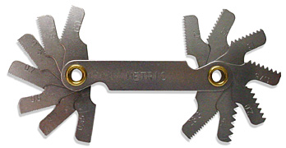
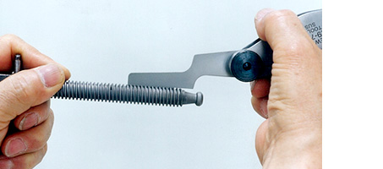
Screw Pitch Gauges
Screw pitch gauges serve as an everyday tool used in picking out a required screw and for checking the pitch of the screw threads.

Slide 14
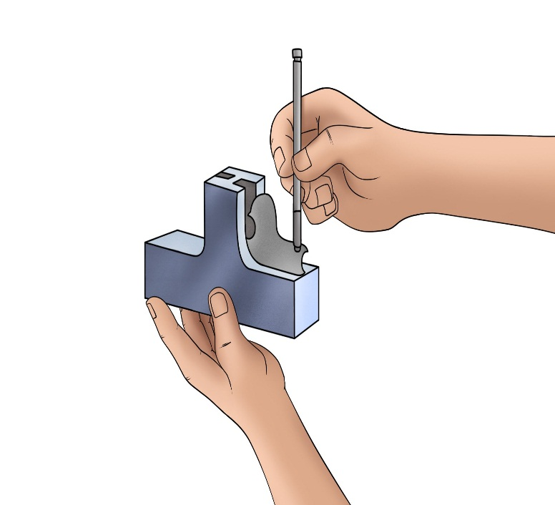
Radius and Fillet Gauges
The function of these gauges is to check the radius of curvature of convex and concave surfaces over a range from 1 to 25 mm

Slide 15
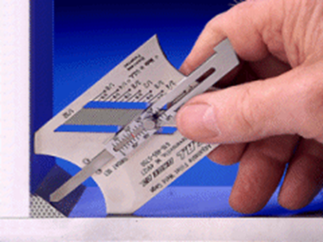
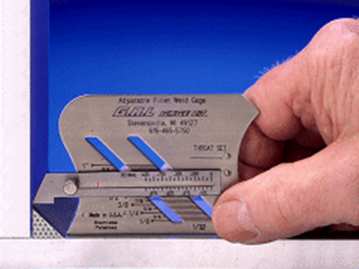
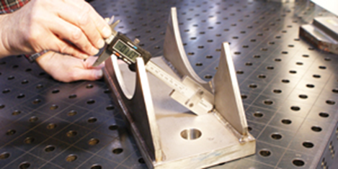
Fillet Gauges

Slide 16
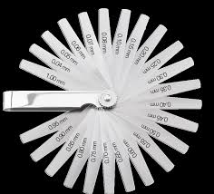
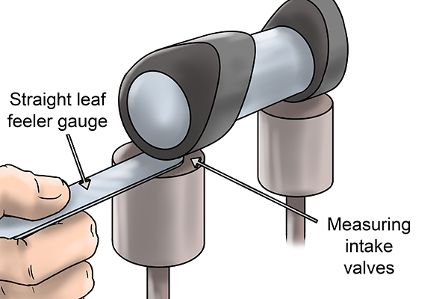
Feeler Gauges
Feeler gauges are used for checking clearances between mating surfaces. They are made in form of a set of steel, precision machined blade 0.03 to 1.0 mm thick and 100 mm long.

Slide 17
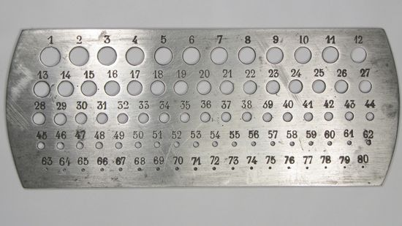
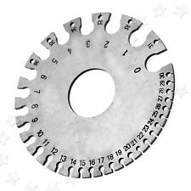
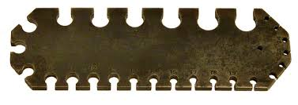
Plate and Wire Gauges
The thickness of a sheet metal is checked by means of plate gauges and wire diameters by wire gauges.

